Slide 1
Bureau ACCESS Plans and Activities
Michael Naughton
Earth Systems Modelling Program
Bureau of Meteorology
CSIRO e-Research and
Computational and Simulation Sciences Conference
Melbourne, 3 April 2016

Slide 2
Contents
Supercomputer upgrade project
UM International Partnership
ACCESS NWP Plans 2015-2020
ACCESS Seasonal Prediction
High resolution NWP for severe weather forecasting
Sydney Forecast Demonstration Project
Snowy Mountains ACCESS vs WRF comparison
Boundary layer clouds study
Bushfires
TC modelling
Darwin and North-West Shelf oil & gas domains
Maritime Continent PEG projects
Impact of improved land surface parameters: urban parameters, tree heights, topography
Soil moisture verification
Surface direct radiance fix
Transpose-AMIP examination of CABLE for NWP
HIWP clouds study

Slide 3

National Priority Project for Petascale Supercomputer Bureau NWP and Seasonal Prediction
Funding over 7 years (2014-15 to 2020-21)
Funds used to:
Buy a new petascale supercomputer
Add new data storage and comms
Host it in a commercial data centre
Upgrade the supercomputer in 2018
We also have to develop:
New high resolution models
New forecast and warning systems
Courtesy Tim Pugh

Slide 5
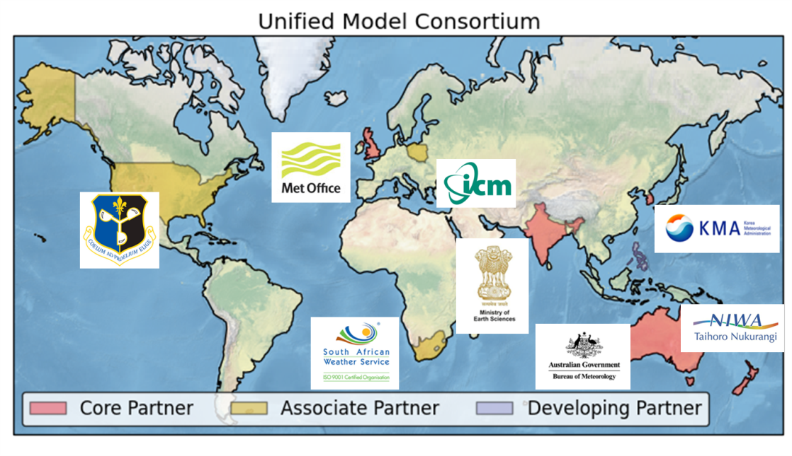
International UM partnerships
Jointly developing a world leading seamless modelling system in a coordinated way
Shared science, model evaluation and technical development:
Joint process evaluation groups
Technical infrastructure teams
User workshops & tutorials
A foundation for relationships with other organisations:
Science & model development
Weather & climate services
Jointly growing our businesses
Operational users complemented by:
research partners in national / international universities & organisations
capacity building consultancy projects with other partners

Slide 6
Advice across all timescales
Past climate
Hours
1-week
Decadal
Now
Days
1-month
Seasonal
Climate
Confidence boundary
Analysis of past weather observations to manage climate risks
Eg. Agriculture: informs crop choice, planting to yield optimisation and minimise crop failure risk.
Predicting routine and hazardous weather conditions.
Public, emergency response, international Disaster Risk Reduction
Monthly to decadal predictions - probability of drought, cold, hurricanes….
Contingency planners, national and international humanitarian response, government and private infrastructure investment
Global and regional climate predictions.
Informs mitigation policy and adaptation choices. Impacts on water resources, heat stress, crops, infrastructure.
Forecast lead-time
Notes:
The Vuvuzela of seamless prediction:
The Met Office is able to make predictions on all timescales from now until a century ahead.
Analysis of past weather data is also useful to understand weather risks today – for example what is the likelihood of a particular storm event occurring.
On longer timescales the confidence boundary gets wider – however if the climate information is applied in an appropriate manner it provides extremely useful information to inform adaptation decision making.

Slide 7
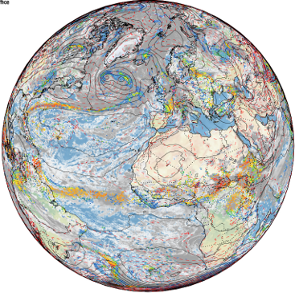
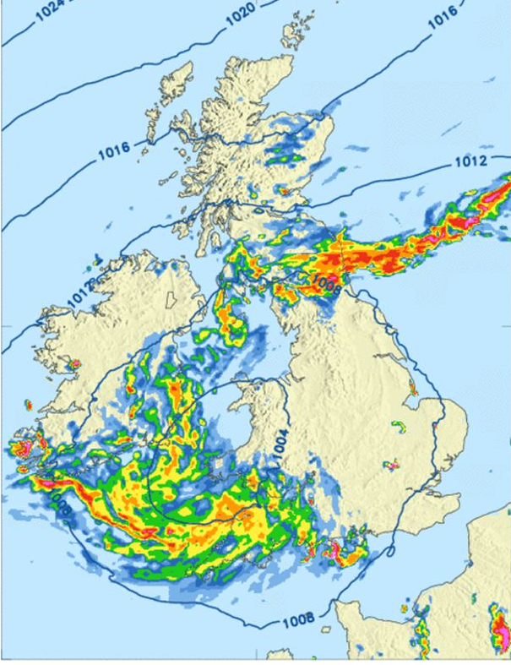
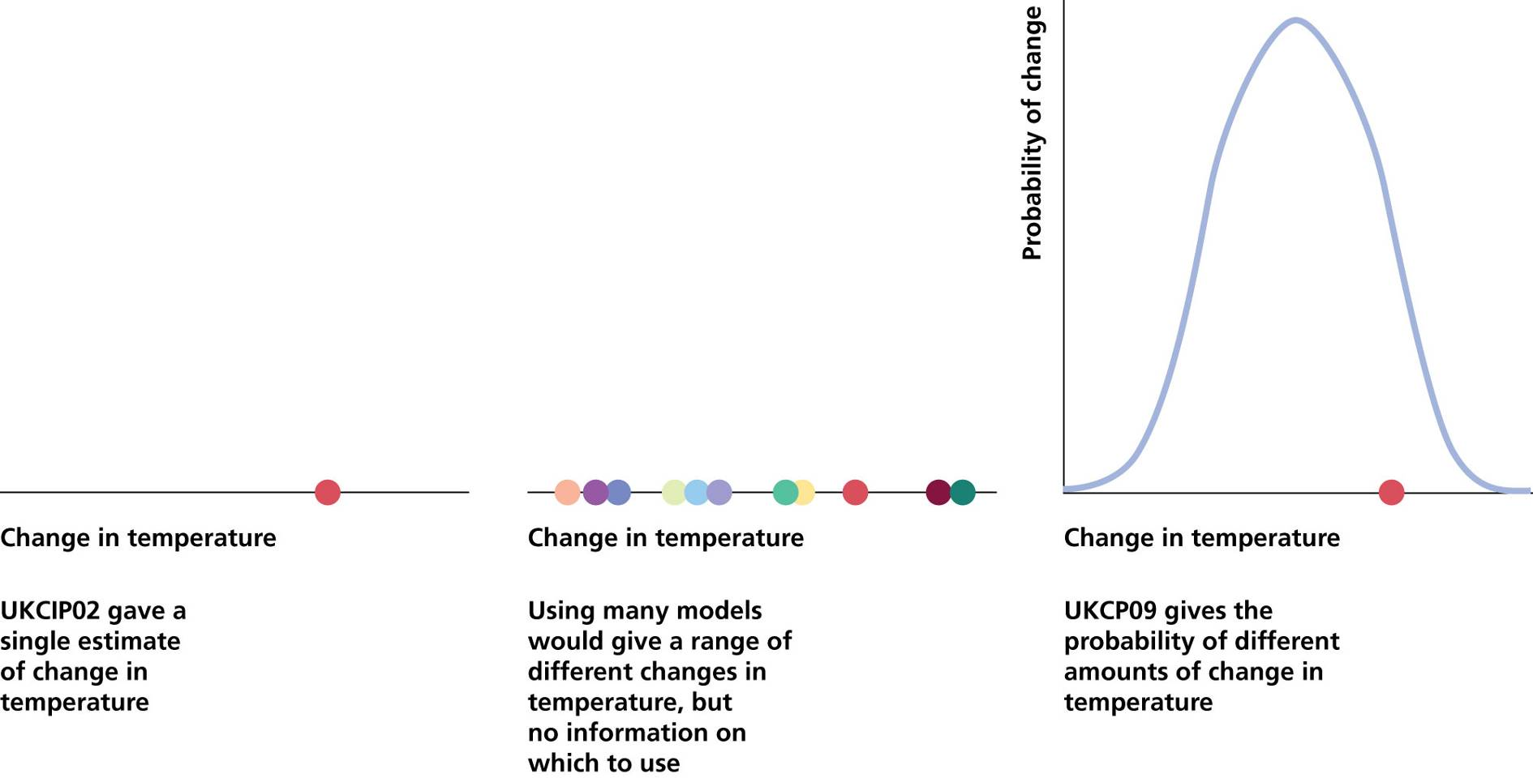
Met Office Modelling Strategy
N x Global coupled model at ~10km with lead times of days to years:
Synoptic drivers
N x local coupled model at ~<=1km :
Local meteorology
PDF of local hazard:
Impacts

Slide 8







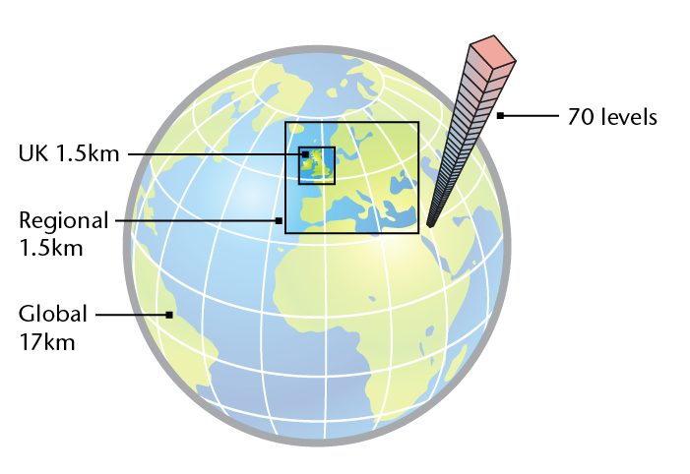
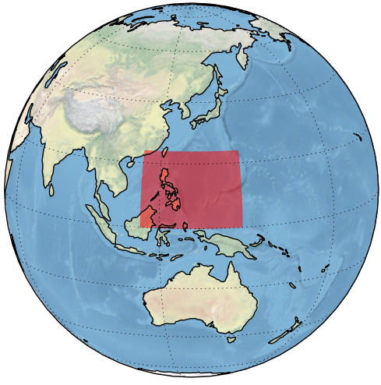
UK Operational Forecasting Models: Based on the Unified Model developed in partnership
UK 1.5km
70 levels
85 with stratosphere
36 hour lead time
8 times/day
+UK ensemble 2.2 km
Regional 4km
T+5 days twice/day
T+60 hour twice/day
+Regional ensemble
Global 17km
Regional models can be re-located rapidly to anywhere on the globe for weather or climate…
T+5 days twice/day
T+2 days twice/day
+Global ensemble
Monthly to Seasonal
60 km atmosphere
¼ deg. ocean
2 ensemble members per day
© Crown copyright Met Office
Notes:
8

Slide 9
Principles of UM partnerships
The more a UM partner can invest and support itself, the more a partner can influence strategic direction of model development and own the UM
Core partners:
Commit 4FTE to joint development
Locally run and support operations & upgrades and fund central support
Member of board sets direction of joint work, controls funds & influences decisions on model development
Associate partners:
Some commitment to joint development
Locally run and support operations & upgrades and fund central support
Feed views to the board
Board
Governing and decision body
Representative from each core partner institute
Technical advisory group
Advises board, plans and coordinates technical work
Representative from all relevant partner institutes
Science advisory group
Advises board, plans and coordinates science work
Representative from all relevant partner institutes
Ad-hoc projects
May be a need to have specific projects from time to time
Representative from all relevant partner institutes
Research partners:
Non operational users able to commit to joint development
May fund central support if needed

Slide 10
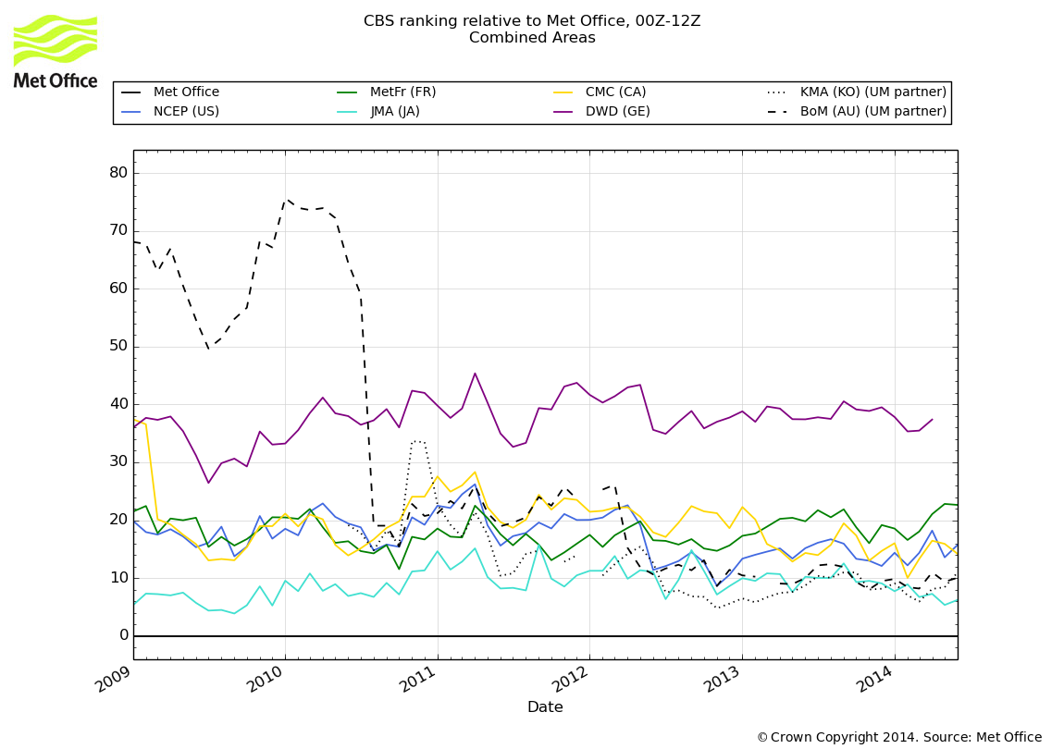
Maintaining our global standing
Global NWP Index (v analysis) basket % difference relative to Met Office
© Crown copyright Met Office

Slide 11
Technical Infrastructure Programme Motivation
Initiated in June 2013 to resolve the priority weaknesses of the research and operational infrastructure.
Goal is a more streamlined, flexible system that is easier to use and adopt for scientific research and operational environments.
Key activities are reviewed annually in a Technical Infrastructure Programme Plan.
Program vision is for an effective scientific collaboration based on:
a common collaborative research approach using underpinning infrastructure
building trust between scientists with collaborative working practices
enable the sharing knowledge by delivering capabilities that deliver a high degree knowledge sharing.

Slide 12








Technical Infrastructure programme launched June 2013
TIAG
Advisory group
TIAV
Data processing &
visualisation
TICM
Common shared repositories
& trac environments
TILS
Land-surface model
interoperability
TICT
UM configuration testing &
system refresh
TIDA
Data assimilation
TIFF
File formats – STASH, NetCDF,
and GRIB2
TIHP
HPC optimisation
TIAN
Stabilising and re-engineering
ancillary file system
TICF
Coupling frameworks
OASIS-MCT
TIRS
Rose development &
migration
Notes:
Not going to have time to talk about all of the work packages but will give a flavour of the most important ones and briefly summarise relevant capabilities/milestones and the benefits that can be realised from successful delivery.
A more detailed account of development and capabilities will follow later today.
Each work package is being managed a separate project wherever possible.
There are 11 work packages currently agreed in the theme plan.
Organisation & individuals have been identified to lead work packages.
Proposals for resourcing work packages in 2014/2015 have been submitted by Partners.

Slide 13
Joint science programme ...
GMED
Global model eval / dev
RMED
Regiona model eval / dev
CMIP6
Joint runs, UKESM eval / dev
TC
Tropical cyclone forecasting
Glosea
Joint seasonal forecasting
DA
Data Assimilation
Notes:
Not going to have time to talk about all of the work packages but will give a flavour of the most important ones and briefly summarise relevant capabilities/milestones and the benefits that can be realised from successful delivery.
A more detailed account of development and capabilities will follow later today.
Each work package is being managed a separate project wherever possible.
There are 11 work packages currently agreed in the theme plan.
Organisation & individuals have been identified to lead work packages.
Proposals for resourcing work packages in 2014/2015 have been submitted by Partners.

Slide 14
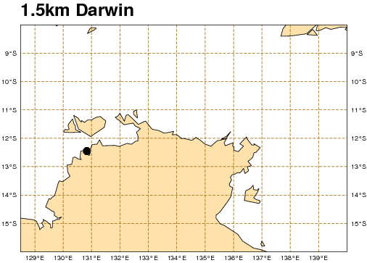
ACCESS NWP Systems – APS2 upgrade (2015-16)
Met Office Unified Model
6 hourly 4dVAR
Global: ~40km (APS1)→ 25km (APS2)
Regional: ~12km (APS1) → 12km (APS2)
TC: ~12km (APS1) → 12km (APS2)
City Systems
4.5km (APS1) → 1.5km (APS2)
No Assimilation
Grey zone -> convection off
Darwin domain added
Ensembles
Global None (APS1) → 60km (APS2)
Limited products available initially
TC
Regional
Notes:
SREP NWP systems will replace current City systems
Will demonstrate why 0.05deg is an awkward resolution
Relocatable facility available – current jobs run with this (just set to constant lat/lon bounds)
NO ensemble prediction component – need other projects to have completed
Focus on Sydney & Brisbane
Brisbane as great tough training/calibration set
Sydney as best obs network

Slide 15
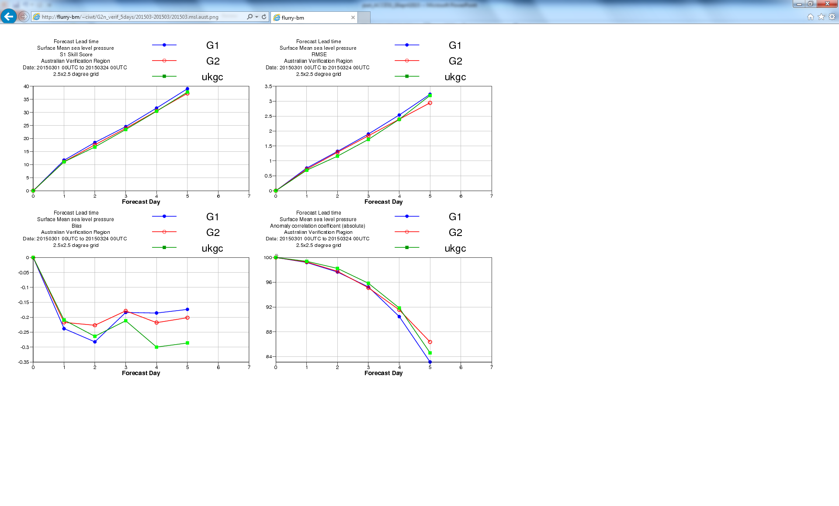
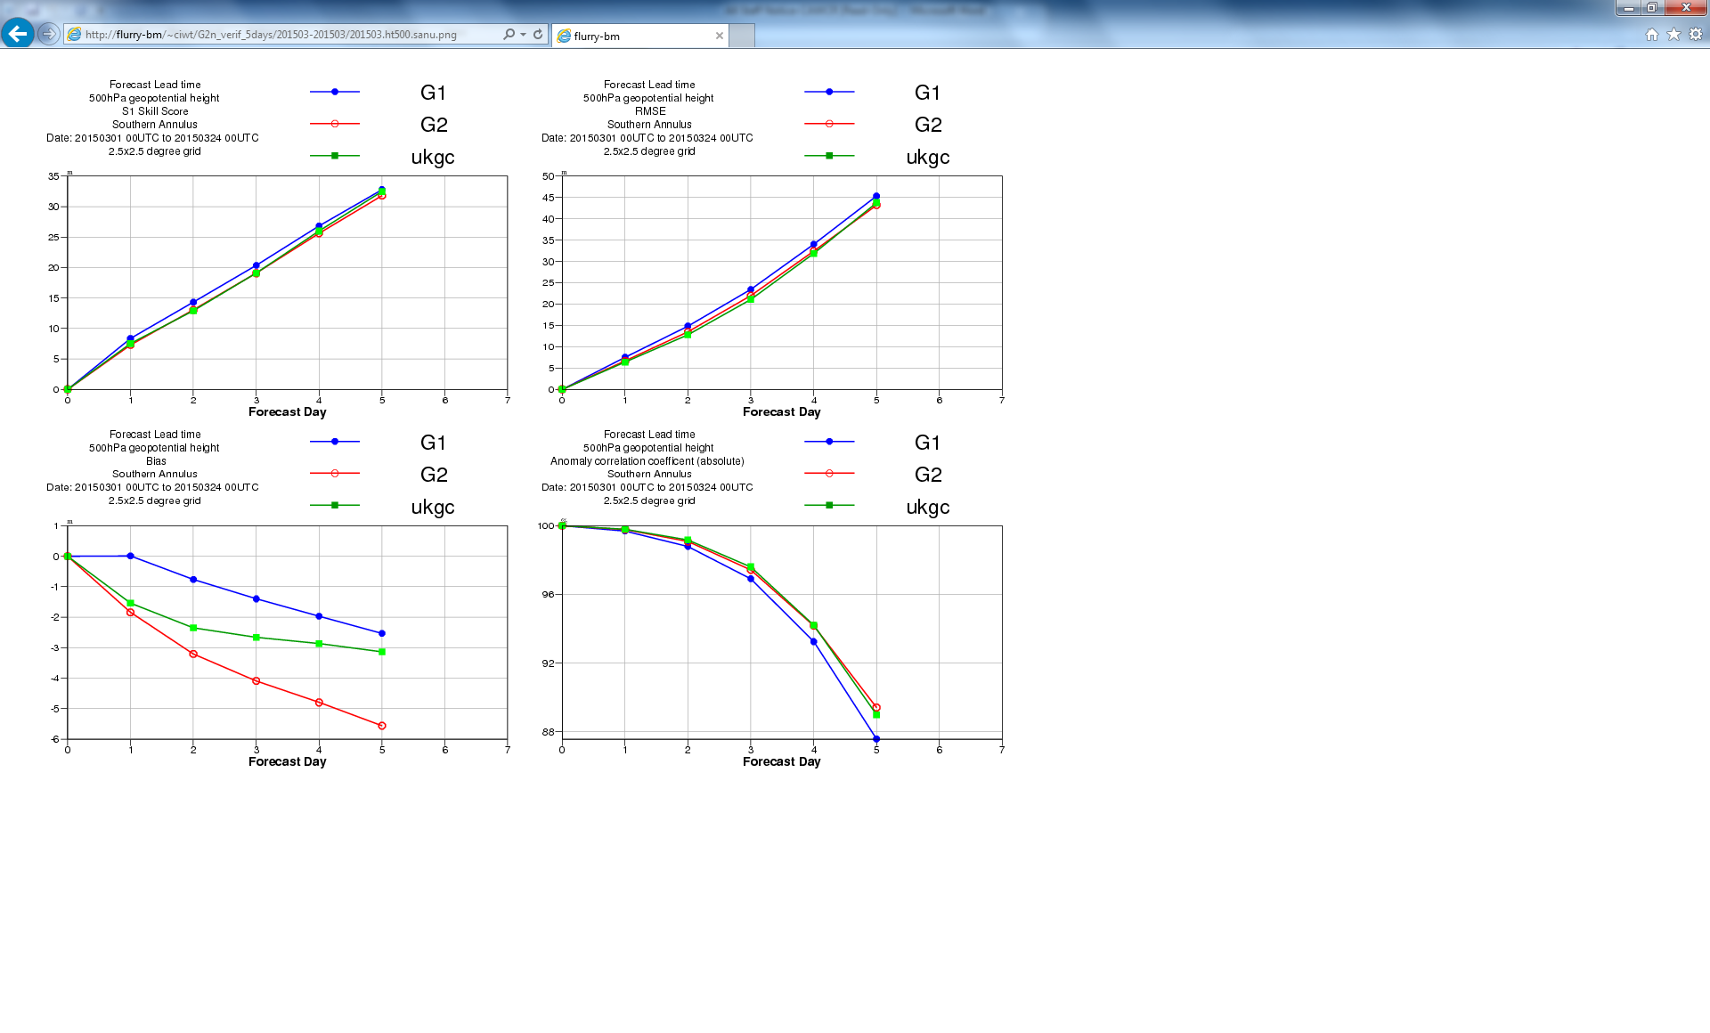
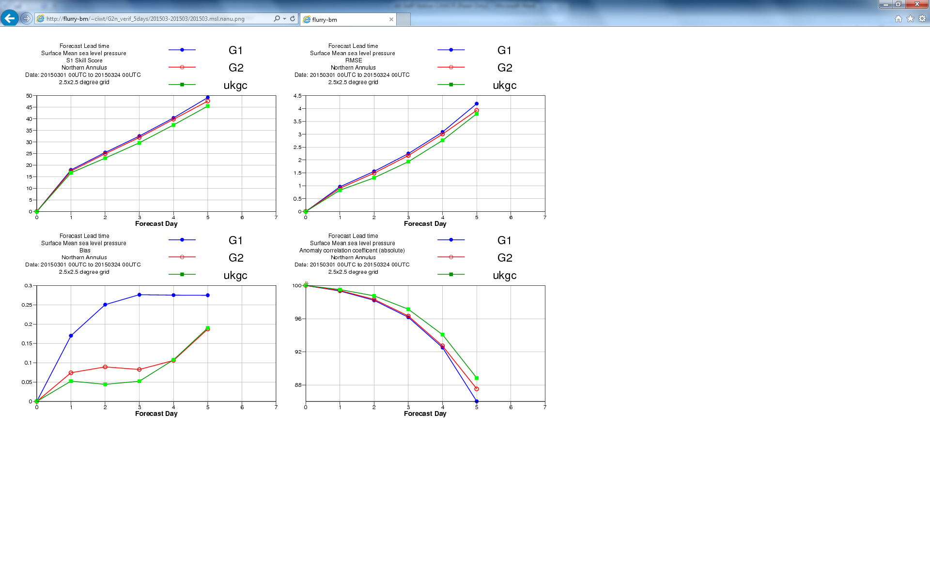
Australian region
S. Annulus
APS2 ACCESS-G verifications
March 2015
Comparison between G1 & G2 and UK global forecasts – verification vs analyses
More improvement in Southern Hemisphere than Northern
N. Annulus

Slide 16
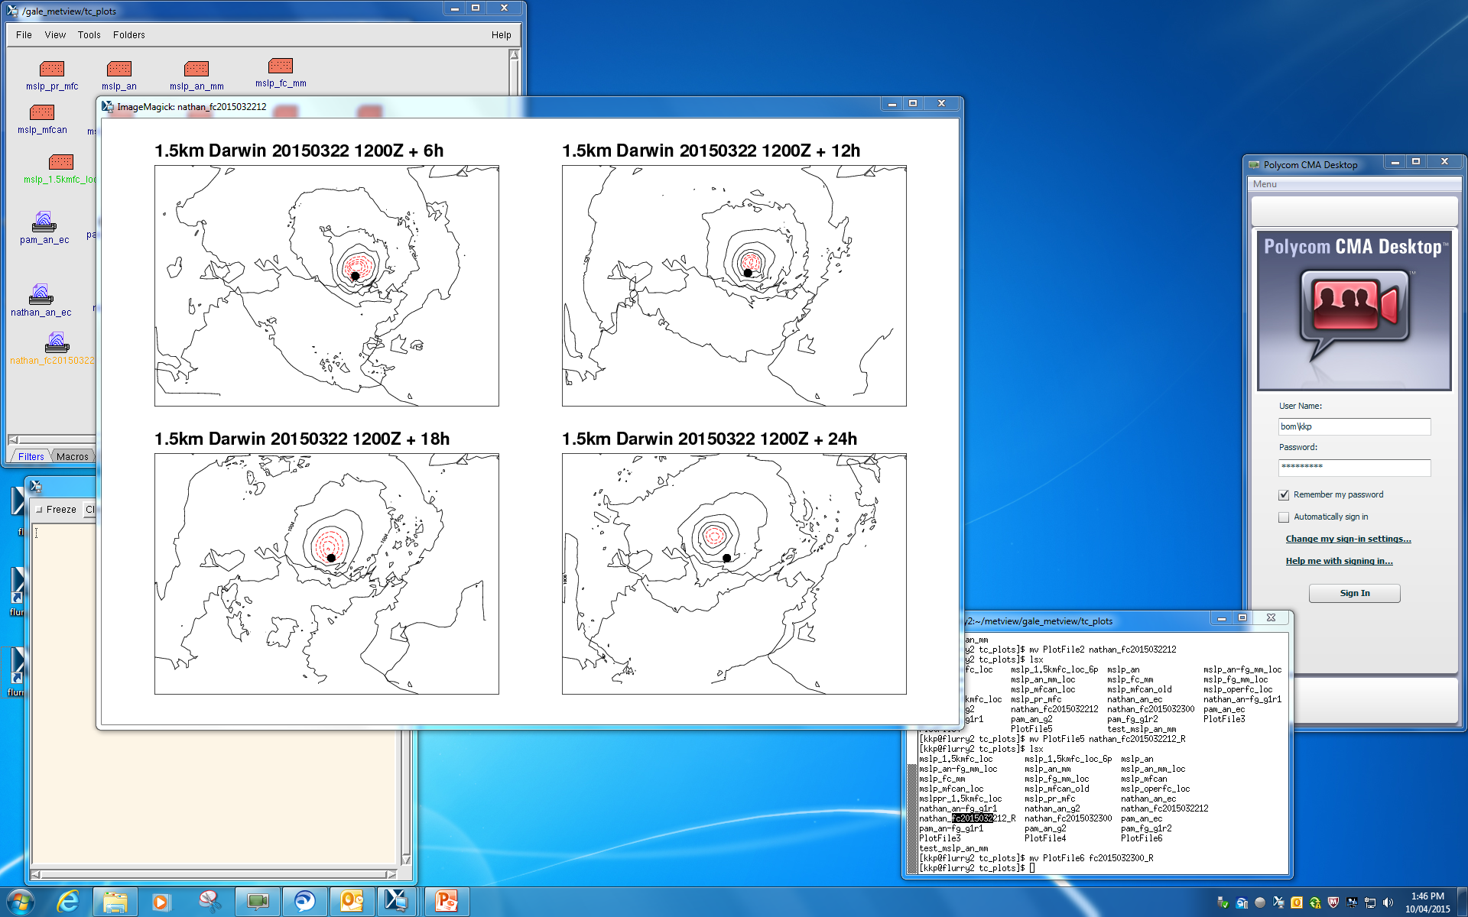
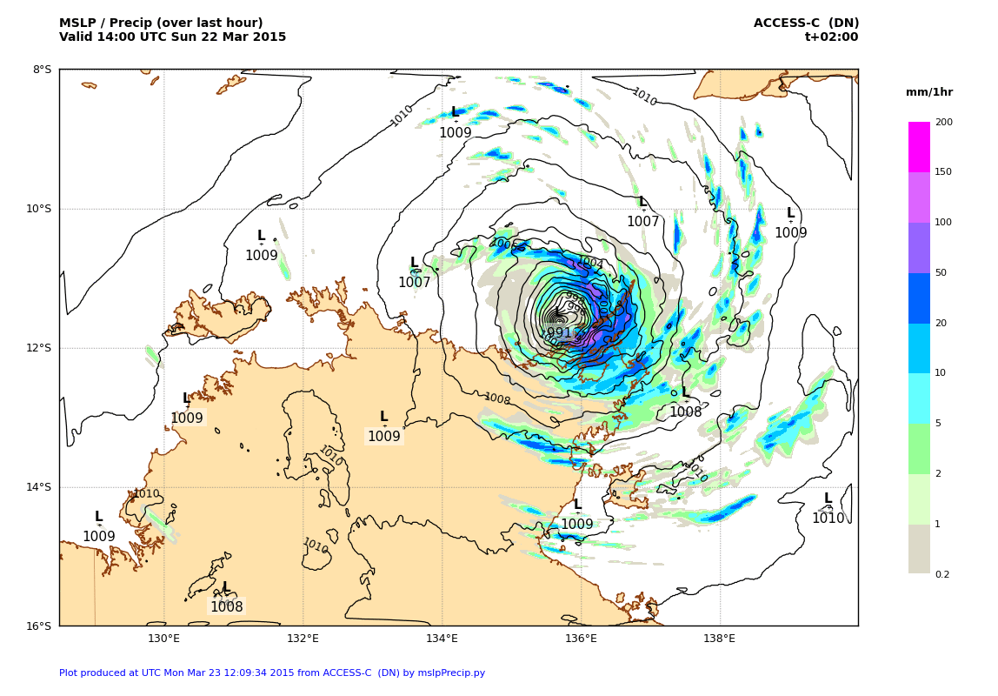
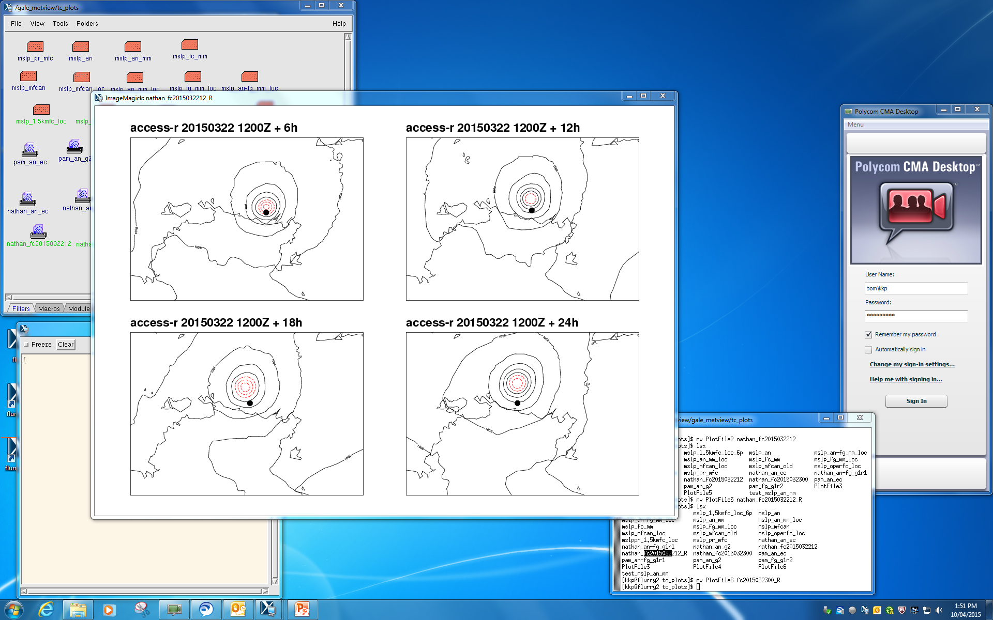
APS2 ACCESS-C Darwin
TC Nathan
IC: 12Z 22 March 2015
6h
12h
1.5km
18h
24h
6h
12h
18h
24h
12 km

Slide 17
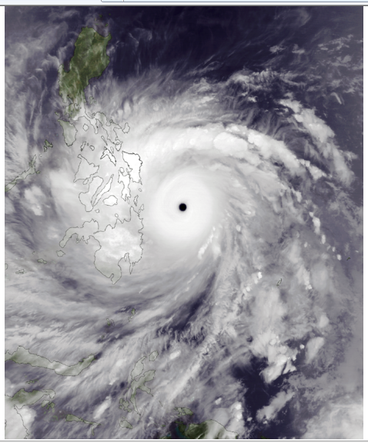
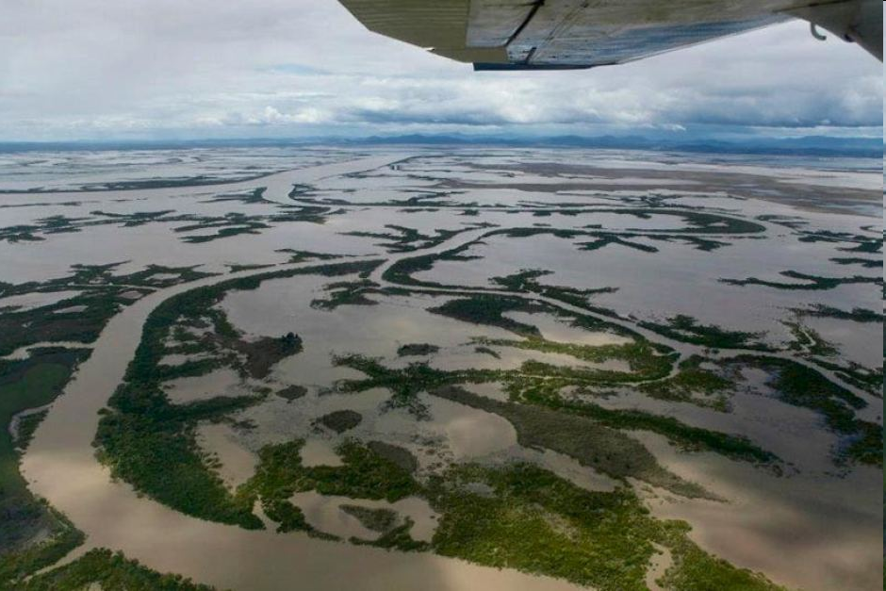
ACCESS NWP future directions
A prime future requirement for operational NWP will be to provide outputs that meet societal needs
Severe weather prediction is a key deliverable
High resolution: 1-1.5km
Data assimilation
Rapid update cycles
High resolution ensembles
Heavy supercomputing demands - NPP

Slide 18
ACCESS NWP Plans
 | APS-2 Op: 2016 | APS-3 Op: 2017-2018 | APS-4 Op: 2019-2020
ACCESS-G | 25km {4dV} | 12km {4dVH} | 12km {4dVH/En}
ACCESS-R | 12km {4dV} | 8km {4dVH} | 4.5km {4dVH/En}
ACCESS-TC | 12km {4dV} | 4.5km {4dVH} | 4.5km {4dVH}
ACCESS-GE | 60km (lim) | 30km | 30km
ACCESS-C | 1.5km {FC} | 1.5km {4dVH} | 1.5km {4dVH/En}
ACCESS-CE | - | 2.2km (lim) | 1.5km
ACCESS-X | - | 1.5km {4dVH} | 1.5km {4dVH/En}
ACCESS-XE | - | - | 1.5km

Slide 19
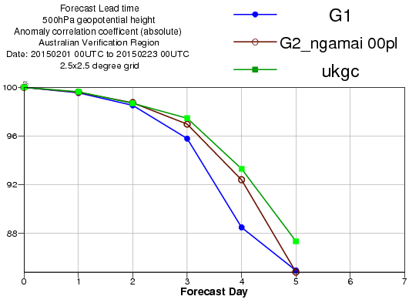
Towards APS2: ACCESS-G
N512 (25km), L70, UM 8.2 trial system running for over a year now
Complete obs-set, including SSMIS, CrIS/ATMS, with exception of windsat
Just handed-over to ops branch, expected to go operational mid-year.
Aust
Notes:
19
Verification for APS2 ACCESS-G ("G2") trial, against current operational system ("G1"), and UK global operational system, Australian region
Australian Region, Feb 2015

Slide 20
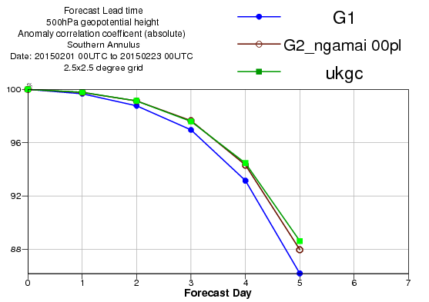
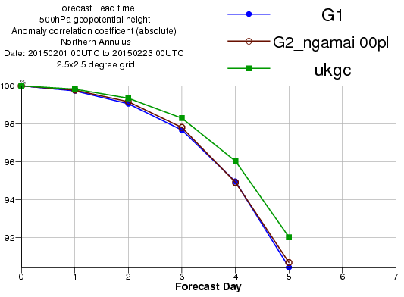
Towards APS2: ACCESS-G
SH
NH
Notes:
20
Good performance gain over Australia, SH, no improvement over NH. Still unsure why – resolved earlier issues with gravity-wave / topography-resolution interaction, but stumped since.

Slide 21
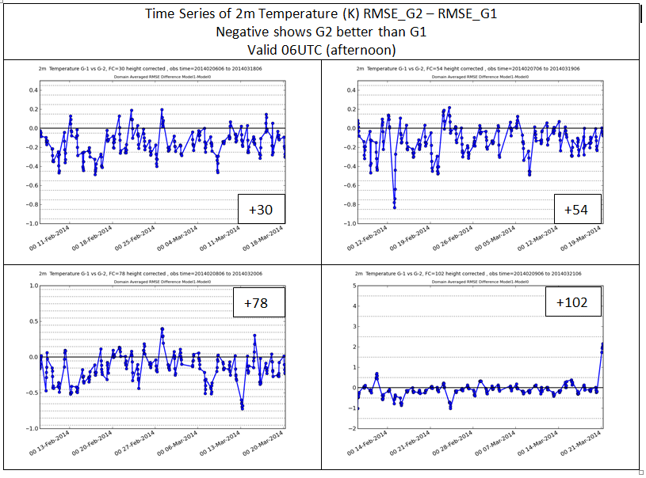
Towards APS2: ACCESS-G
Surface verification
Improvements in first 2-3 days
2% improvement in wind-speed, 4% in temp
Notes:
21
Note: Error(G2) – Error(G1) == negative is "good" (G2 better than G1)
Slight improvement in 10m windspeed, of about 2% mainly during the first two days and in the afternoon and evening
2m temperature and dewpoint improved by about 4% during the first 3 days biggest gains in first 48 hours and during the afternoon and evening. (i.e. Tmax improved more than Tmin)
Forecast length shown in boxes ("+30")

Slide 22
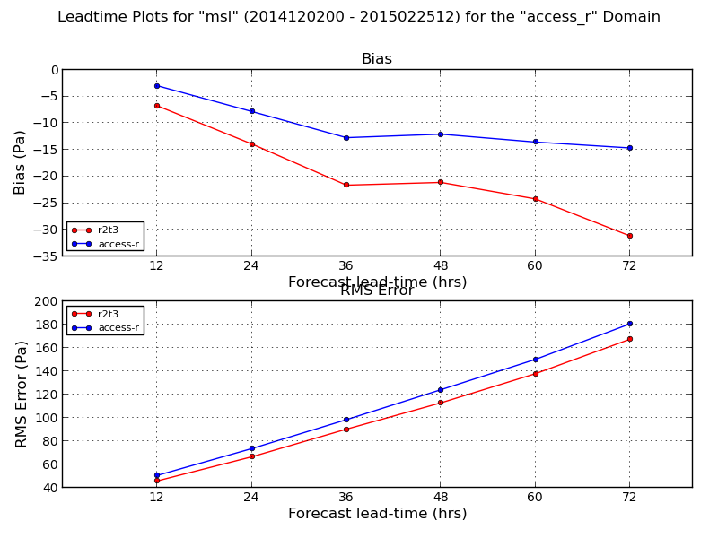
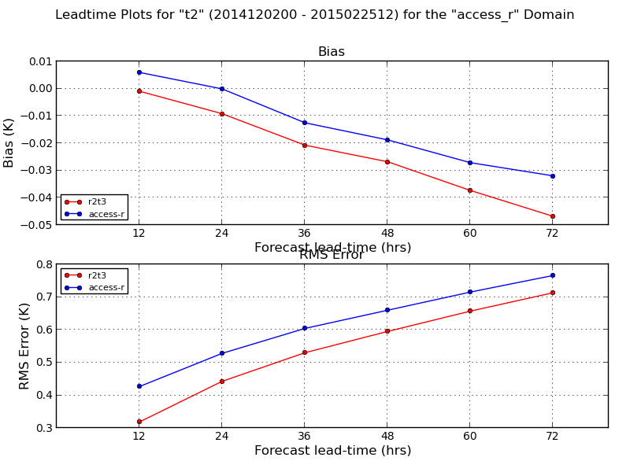
Towards APS2: ACCESS-R
Regional model has same data-streams as global, and UM is upgraded (8.4), but resolution unchanged
Medium term uncertainty over regional-modelling
Improved local-topography, R-domain-specific covariances
Verif shows more improvement than we were expecting
Hand-over date June, operational by end of year
Notes:
22
"Uncertainty" – where does regional model fit between increasingly high-resolution global, and the city-based / on-demand very high-resolution systems ??? Can no longer rely on UKMO "NAE" model as a base.
"access-r" (blue) = operational system (R1)
"r2t3" (red) = trial APS2 ACCESS-R (R2) system
Mslp to left, screen-temperature to right. Be careful of the vertical-scales R2-Tscr has worse bias, but difference is small!

Slide 23
Towards APS2: ACCESS-C
C2 is still a down-scaler (FC-only) system, like C1
Convection-permitting (ala UKV): 1.5km res, down from 4km.
Significant computational challenge to "fit" on current SC
Importance of I/O server for R2 (BC and ICs)
More tightly inter-leave running of "R" and "C", stagger some of the "C" domains in time.
Trial evaluation currently underway
Several examples of C2 avoiding the coastal-locking of rainfall in certain scenarios in C1.
Hand-over to operations anticipated in July
Notes:
23
"C2" = APS2 ACCESS-C
"UKV" = UKMO 1.5km variable-resolution (stretched-grid)

Slide 24
Towards APS2: ACCESS-GE
Will be our first ACCESS-based operational ensemble system
Based on UKMO MOGREPS
Global ensemble to 10 days
Global ETKF for initial condition perts
Stochastic model perturbations
Currently running 12Z daily at 60 km, 70 levels (N216L70)
Comparable performance to major O/S systems
Hand-over to operations expected in 3rd-quarter
Notes:
24

Slide 25
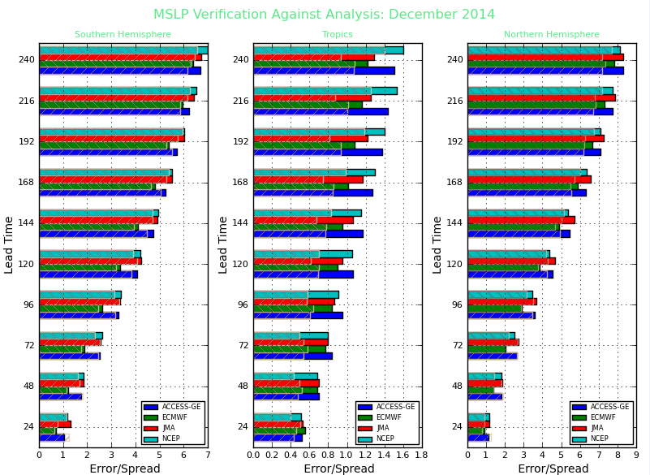
APS2: ACCESS-GE
ACCESS-GE
ECMWF
JMA
NCEP
MSLP
December 2014
SHEM TROP NHEM
Notes:
25

Slide 26
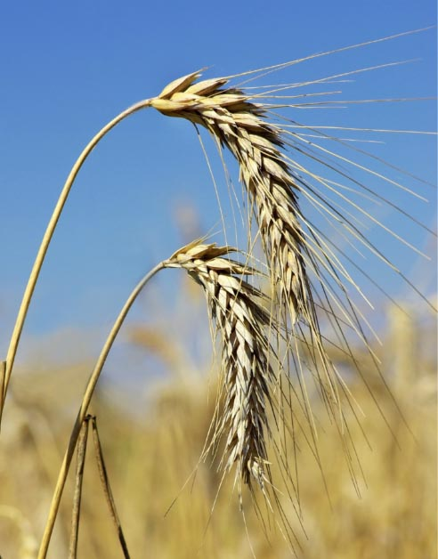
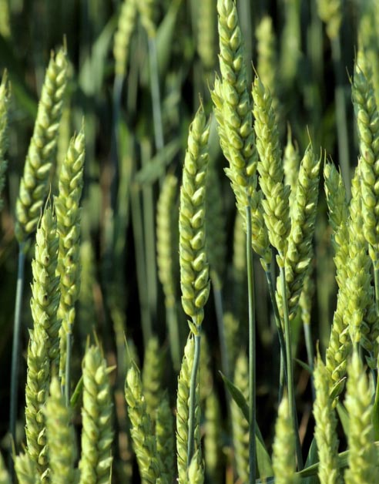

Improved Seasonal Forecast System
Debbie Hudson, Oscar Alves, Harry Hendon

Slide 27
Background
BoM's seasonal forecasts have become more skilful with recent versions of the system, but user expectations and performance is still inhibiting uptake by users
Increasing demand for multi-week and seasonal forecasts
Present system (POAMA-2) is low resolution (250 km) and based on no longer supported models
Prior to April this year development focussed on POAMA-3 ---150 km resolution with same model configuration as for climate change studies (UM atmosphere, MOM ocean)
POAMA-3 already lower resolution than systems operating at other leading centres and the current approach means that we will always be at least two to four years behind the latest developments available from the UKMO

Slide 28
Plan
New the system: ACCESS-S
Deliver a high resolution seasonal prediction system at reduced cost, reduced forecast risk and on a significantly shorter time frame compared with the past approach
Use latest version of the UKMO coupled model: UM atmos N216 (~60km in midlats) L85; NEMO ocean 0.25° L75
Implement local data assimilation and ensemble generation
Option for joint hindcasts and forecasts with UKMO
Play significant role in contributing to UKMO development

Slide 29
Plan: Phase 1
Fast track phase : transfer to operations for trial mid-2016*
UKMO GC3 (stochastic phys, greenhouse gases, etc)
UKMO initial conditions + local ensemble generation
Hindcasts increased from 15 to 25 years
Hindcasts members increased from 3 to 10
Real-time forecasts 2 per day from UKMO + at least 3 per day from BoM
6 months lead (could do longer using local forecasts only)
*Note: exact timelines for delivery depend on funding and supercomputer

Slide 30
Plan: Phase 2
Full suite phase: transfer to operations for trial mid-2018*
UKMO GC4/5 (reduced tropical biases e.g. Indian Ocean)
Local Coupled EnKF for assimilation and ensemble generation
Hindcasts locally 35+ years (joint with UKMO?)
Hindcasts members at least 10 (joint with UKMO?)
Real-time forecasts at least 5 per day (+UKMO ones?)
1 year lead (?)
*Note: exact timelines for delivery depend on funding and supercomputer

Slide 31
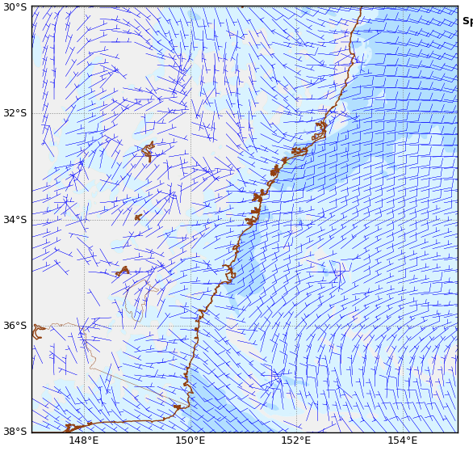
Rapid Update Cycle – Hourly 1.5km experimental system
Aim: High res. NWP guidance using radar data
Configuration
3DVAR
1-hourly analysis cycle,
data cut-off ~60mins
Issues with 4dVAR stability
Latent Heat Nudging
Test cloud assimilation
Doppler winds
Best coverage is over Eastern NSW (Sydney Domain)
Single polarization → QC via Bayesian classifier
Peter Steinle et al.

Slide 32
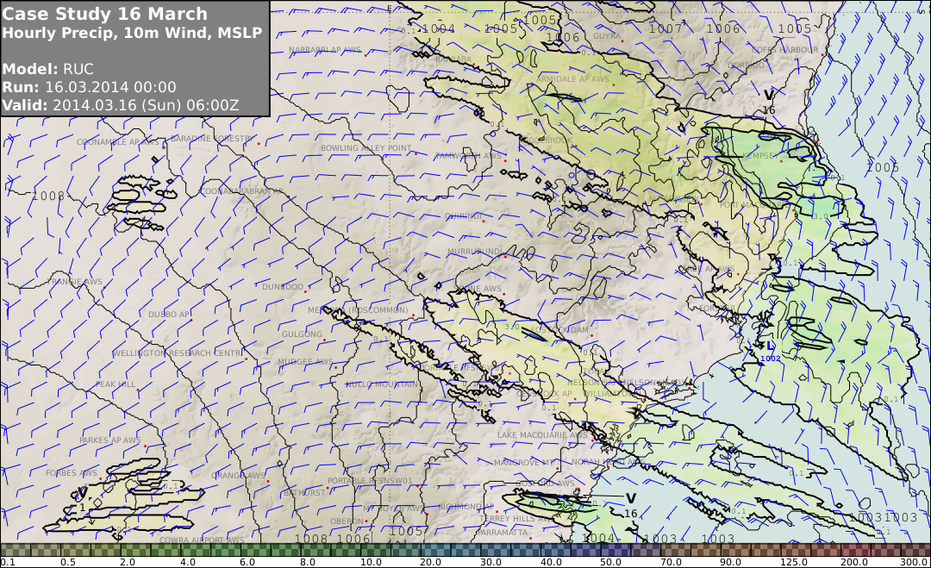
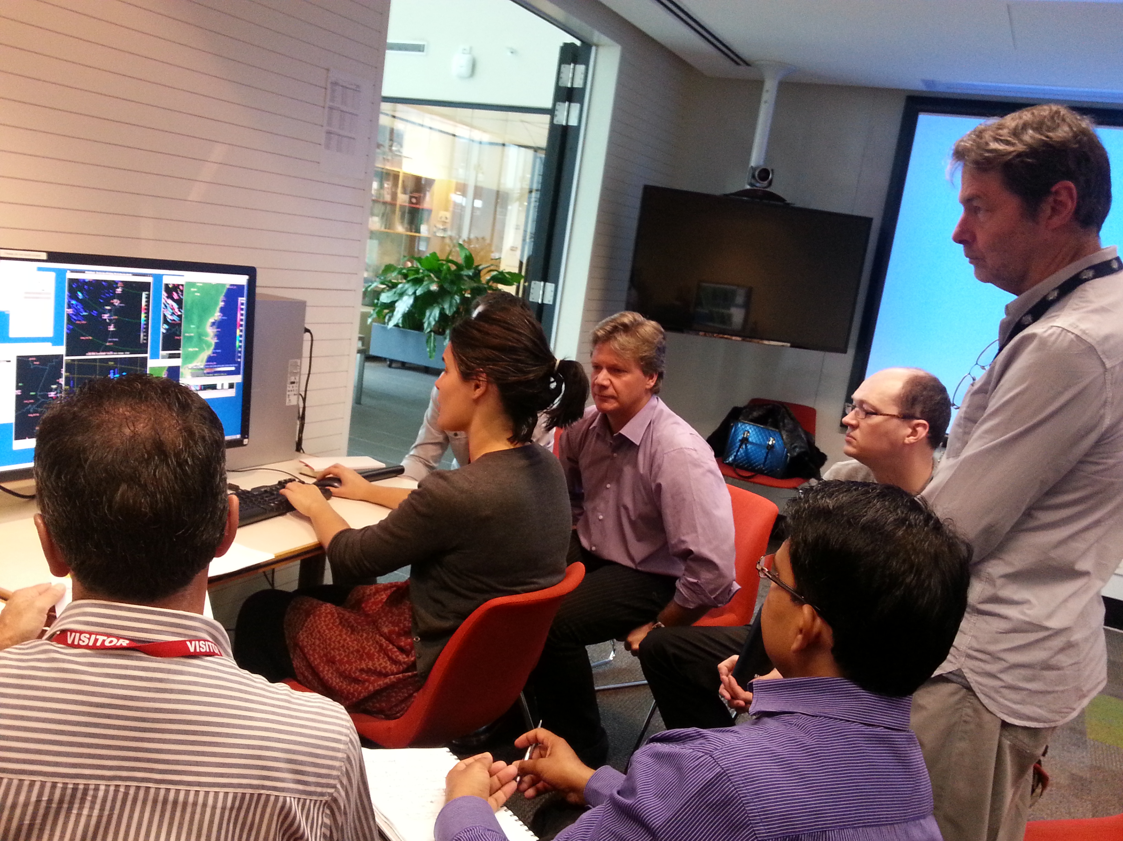
Sydney Forecast Demonstration Project
Late Sep – early Dec 2014
What new things can we do
What old things can we do better
Incorporate RUC into forecasting applications
Forecast Editor/Generator
Data visualization
Nowcasting applications
Post processing applications
Mimic operational forecast office
Some external participants
For their evaluation
Peter Steinle et al.

Slide 33
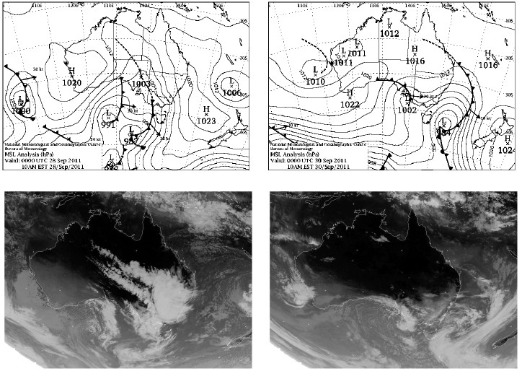

Evaluation of ACCESS-C forecasts of wintertime precipitation over the Snowy Mountains - a comparison with WRF simulations
Vivian Huang, T. Chubb, S. Siems, M. Manton, C. Franklin
12 UTC Sep 27 – 12 UTC Oct 01, 2011: NW and deep moisture
Largest daily precipitation amount of the whole winter of 2011
00UTC Sep 28
00UTC Sep 30

Slide 34
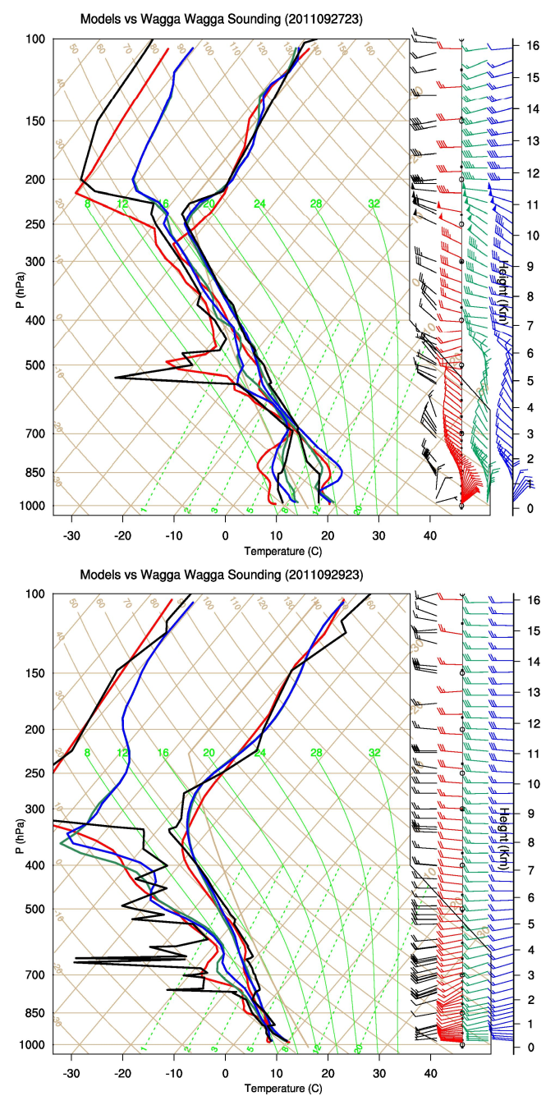
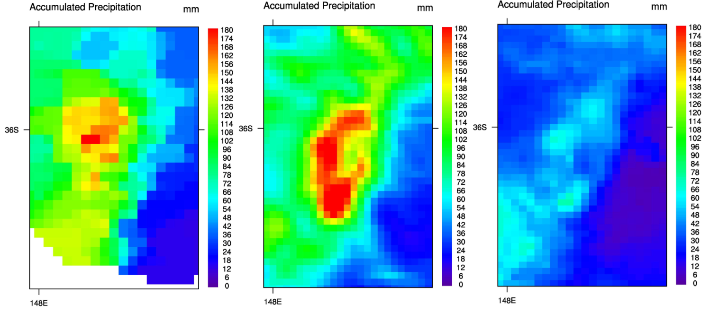
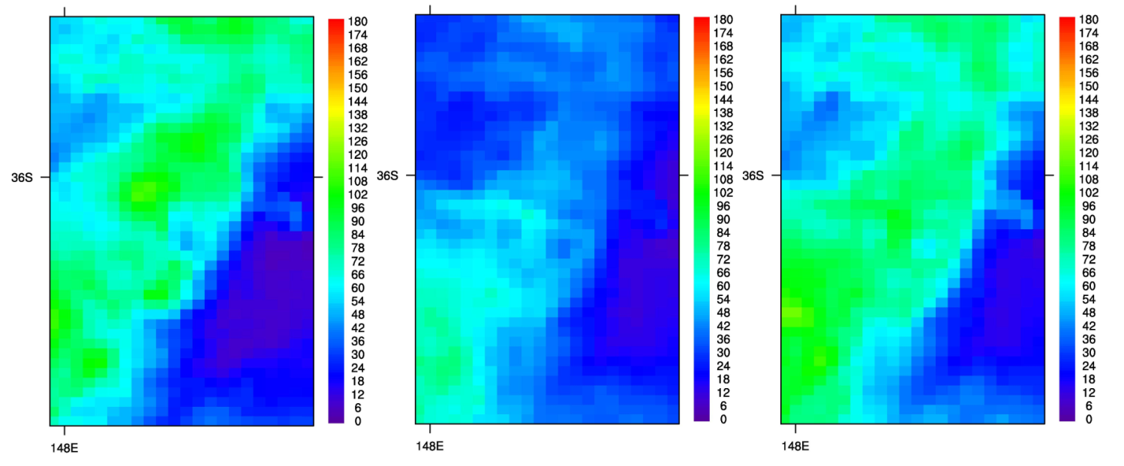
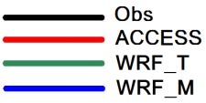
OBJECTIVE ANALYSIS
ACCESS
WRF_Thompson_default
WRF_Thompson_test
WRF_Morrison_default
WRF_Morrison_test

Slide 35
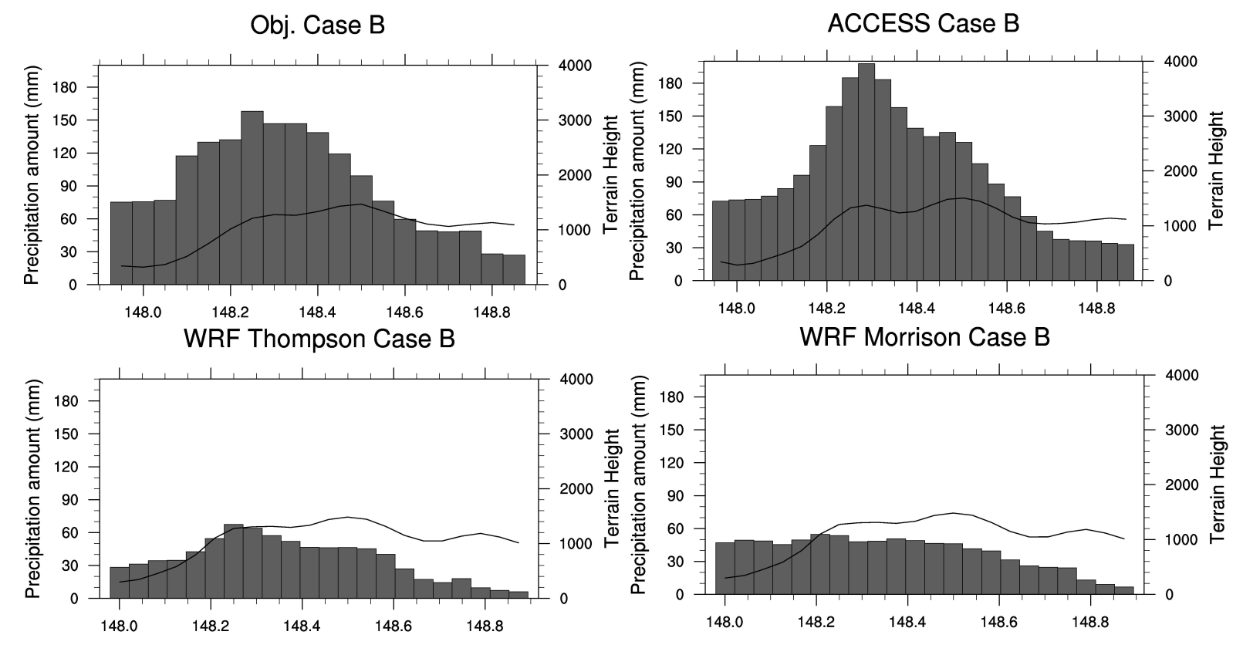
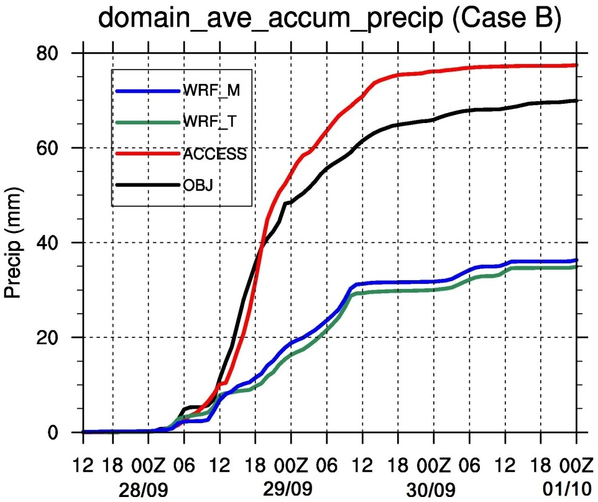
Forecast rainfall by ACCESS is highly sensitive to topography.
No significant orographic enhancement
WRF significantly underestimates the accumulated amount of rainfall (~50%).
All the simulations capture the onset of the precipitation reasonably well.

Slide 36
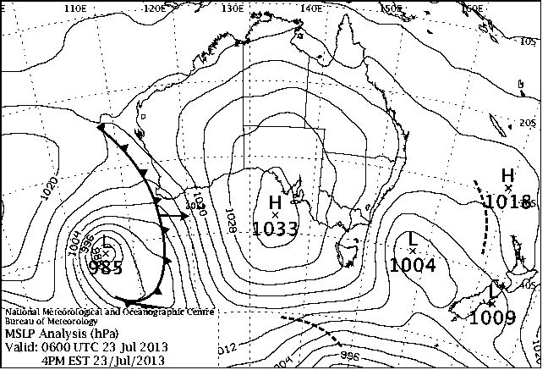
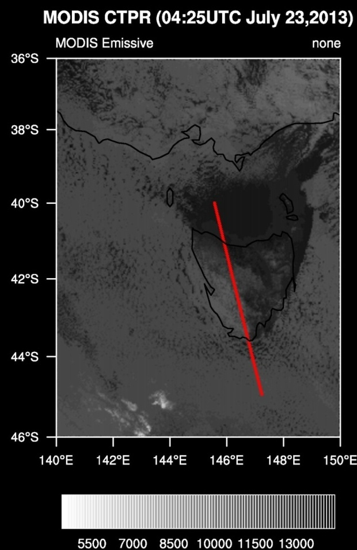
An Evaluation of ACCESS-C forecasts of Boundary Layer Clouds over the Southern Ocean
Vivian Huang, C. Franklin, S. Siems, M. Manton, T. Chubb, A. Lock
Satellite overpass: 04:25 UTC July 23, 2013
A-Train track: South Cape
High pressure ridge
SSE(observed)/SSW(models)
Large field of boundary layer (BL) clouds
Aerosols underneath clouds

Slide 37
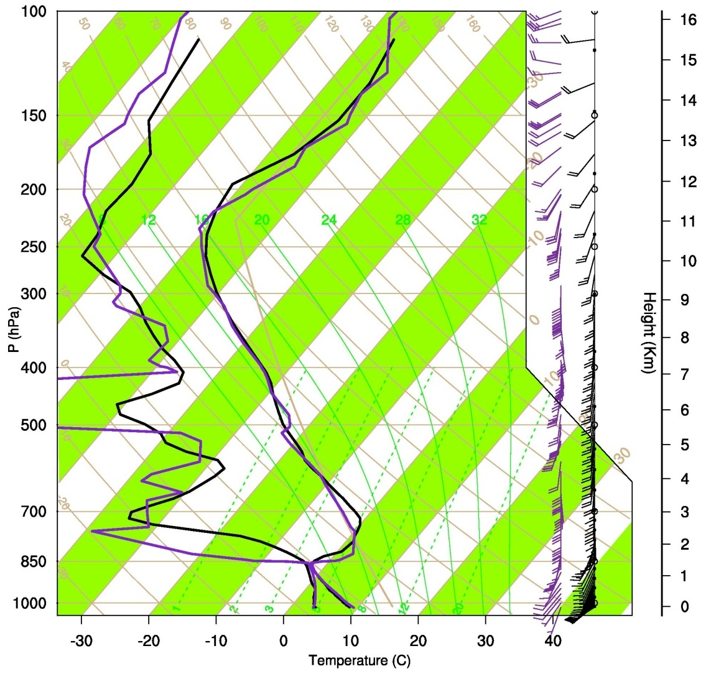
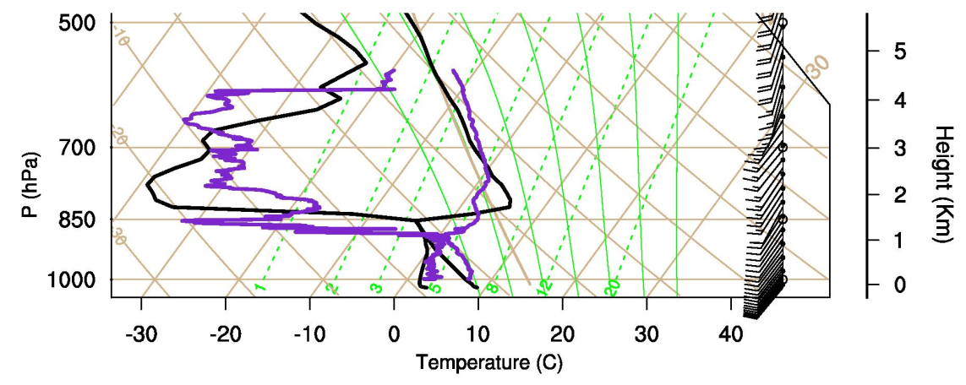
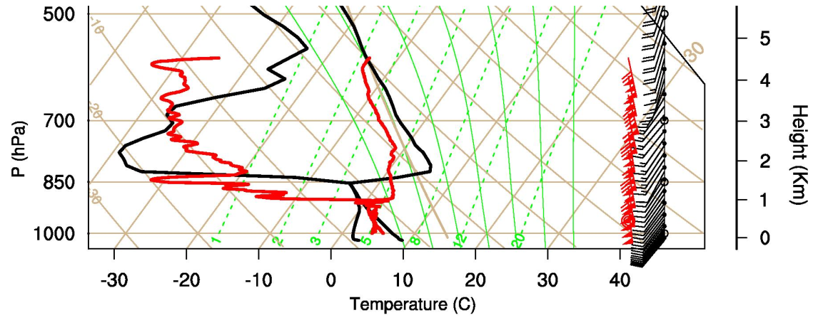
Evaluation of soundings
ACCESS vs. Hobart
23UTC 22/07/2013
ACCESS vs. aircraft
~04UTC 23/07/2013
Ascent
Descent

Slide 38
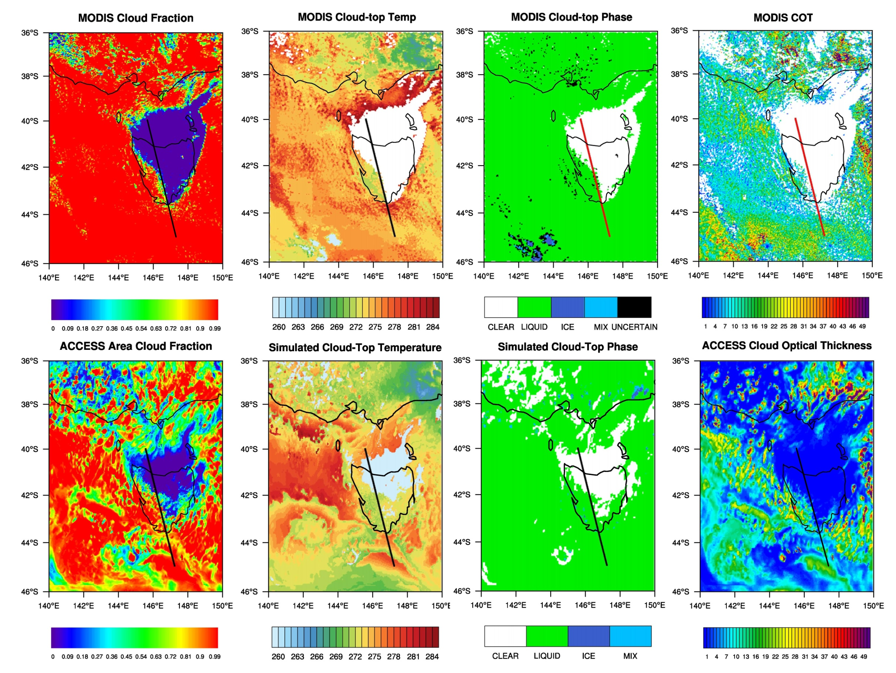

Slide 39
High impact weather modelling team TCs, Bushfires, Aviation, Severe TS, etc.
To improve our understanding of and ability to predict severe weather, including for bush fires, tropical cyclones, severe thunderstorms and heavy rainfall, through the use of high-resolution modelling in conjunction with available observations
Jeff Kepert et al.

Slide 40
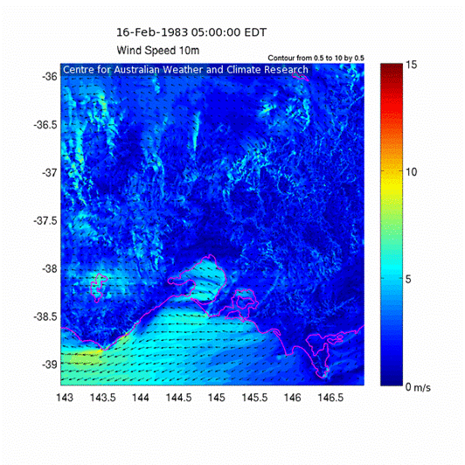
Wind speed and direction Ash Wednesday, 1983
400 m grid
ACCESS simulation on 400-m grid.
Marked wind change
Roll circulations ahead of change from late morning
Strong post-frontal winds caused severe fire behaviour, many deaths
Thunderstorm downdrafts ahead of change
Jeff Kepert et al.

Slide 41
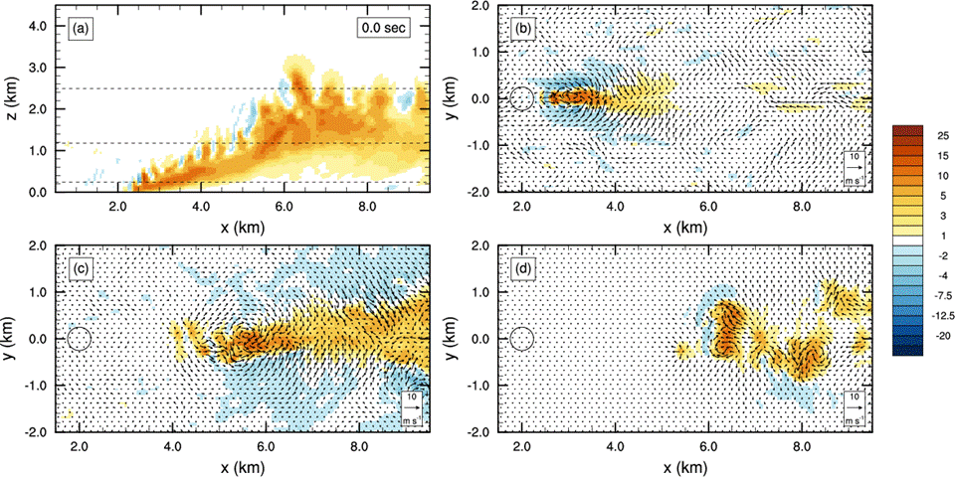
Plume dynamics LES, 15 m s⁻¹ wind
Jeff Kepert et al.

Slide 42
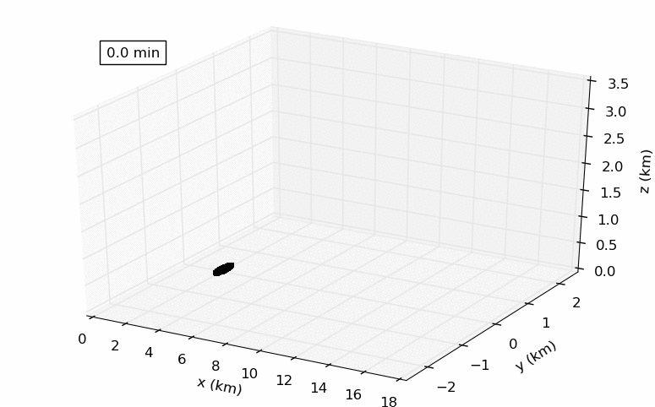
Firebrand transport LES, 15 m s⁻¹ wind
8265 particles released every 5 s for 15 min = 1,487,700 total
Only every 100th particle is shown here
478,058 (32.1 %) travel > 1 km
Jeff Kepert et al.

Slide 43
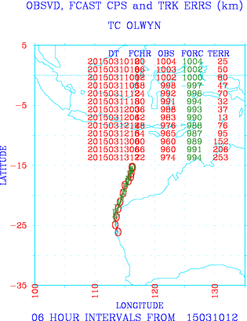
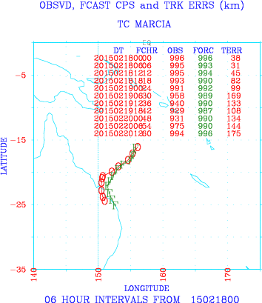
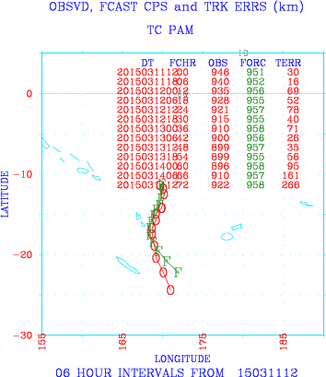
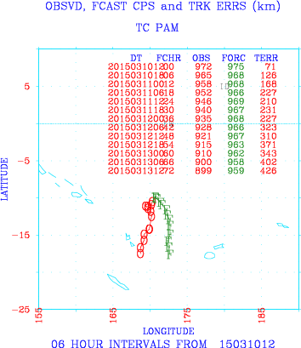
APS2 ACCESS-TC
Track Verification for 2014-15 Australian Region Storms
5 TCs = Lam, Marcia, Nathan, Olwyn, Pam
At 0 hrs, Mean TRK Err for 47 Forcs = 23.3 km
At 24 hrs, Mean TRK Err for 44 Forcs = 76.9 km
At 48 hrs, Mean TRK Err for 37 Forcs = 136.3 km
At 72 hrs, Mean TRK Err for 29 Forcs = 235.7 km
Quite impressive in absolute terms.
Positive impact on APS1 ACCESS-TC, out to 48 hours (not shown).
Nice improvements in initialization of vortex and environmental, steering flows.
Some examples of the many good, but still a few poor forecasts.
………………………………………………………………………………………………………………………………..
Noel Davidson, Yi Xiao et al.

Slide 44
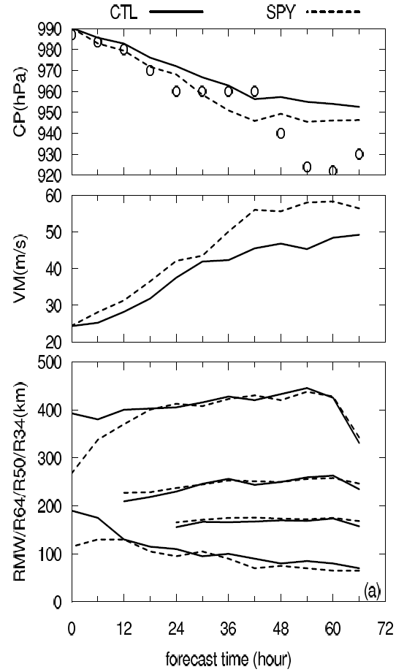
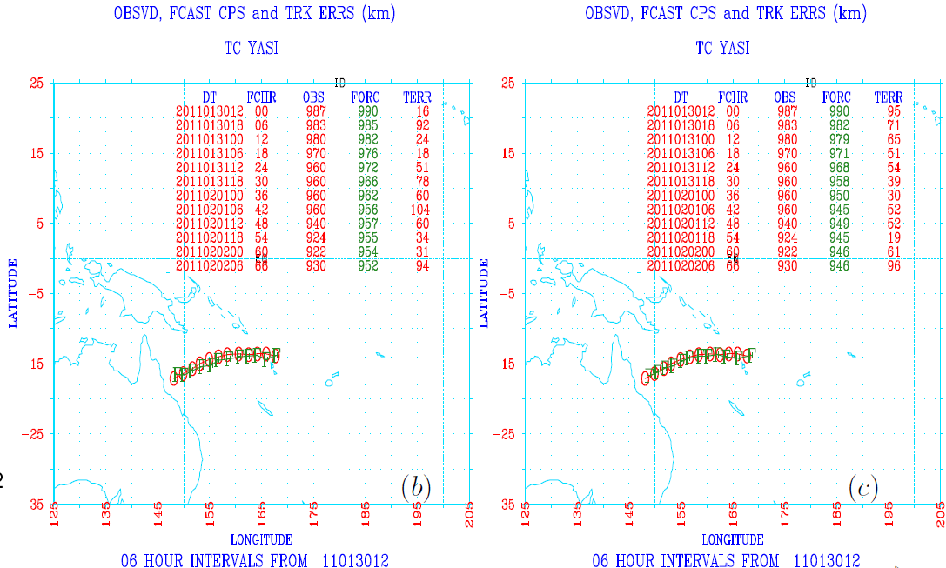
Spray Route Scheme – Revised Parameterisation of Air-Sea Exchanges in High Winds: Impact on Tropical Cyclone Track, Intensity and Rapid Intensification
Time series of simulated central pressure (CP), inner core parameters of maximum wind (VM) and radius of maximum wind (RMW), radius of 34 knots (R34), using the bulk algorithm (CTL) and the spray route scheme (SPY). The best-estimated CP is indicated with ”o”.
Yimin Ma et al.

Slide 45

NW Australia Extended-Range TC Forecasts
Project initiated by offshore oil and gas, NW Aust
Main aims:
Forecasts to 5 days
Better forecasts of genesis and intensity
Wave forecasts under TCs
Proposed solution:
Extended domain limited area, not relocatable
Resolution increase from ACCESS-TC (from 11 km to 4 km)
4D-Var with vortex specification (bogussing)
Daily running, not just when a cyclone is named
One-way coupled to wave model
Some similarities to MetOffice’s P4.4 system, but will include assimilation
Xingbao Wang, Jeff Kepert, Noel Davidson et al.

Slide 46
Maritime Continent PEG Summary of 12 May 2015 meeting
Modelling: UM AMIP and NEMO-WRF regional coupled models produce less rainfall bias over the MC if increasing the horizontal resolutions, likely due to better simulated orography & diurnal cycle. Mixed layer coupled modelling (KPP) provides a cheap tool and simulates better MJO eastward propagation. Super-parameterized AGCM also provides good MJO propagation.
Model tuning: Modified melting levels reduces rainfall bias over MC. Increasing local SST (0.3C) showed the similar effect.
Process understanding: Cold surge contributes 20-40% rainfall over MC. Bias in horizontal moisture convergence controls the local rainfall bias. Large-scale circulation has minor impacts on coastal rainfall over MC.
Observation: Large uncertainty the MC area including satellite retrievals. Model biases shown will depend on the reference observations. YMC shall provide better quality of observations.
Jing-Jia Luo, Harun Rashid, Hongyan Zhu et al.

Slide 47
Impact of Buildings and Trees Surface verification over Jun/July 2014
New Urban Parameters and Tree Heights + New Orography-Lakes
RMSD from Observed
 | Screen Temperature (K) |  |  | Screen Dew Point (K) |  | 10m Wind Speed (m/s)
MARS ID | 0001 | 3101 | Improv | 0001 | 3101 | 0001 | 3101
Sydney | 1.98 | 1.81 | 9% | 1.87 | 1.73 | 2.08 | 1.96
VicTas | 1.71 | 1.62 | 5% | 1.59 | 1.54 | 2.01 | 1.94
Adelaide | 1.48 | 1.45 | 2% | 1.68 | 1.63 | 1.68 | 1.68
Perth | 1.67 | 1.59 | 5% | 1.86 | 1.78 | 1.88 | 1.94
Brisbane | 2.24 | 1.79 | 20% | 2.18 | 2.04 | 1.59 | 1.55
Darwin | 2.03 | 1.87 | 8% | 2.50 | 2.39 | 1.57 | 1.91
OLD
NEW
DIFF
Imtiaz Dharssi

Slide 48



VERIFICATION of Soil Moisture ANALYSES from Global NWP Models USING Ground Based Observations
Vinod Kumar & Imtiaz Dharssi
Bureau of Meteorology, Melbourne
²⁰¹⁵

Slide 49

CosmOz Soil Moisture Stations
Vinod Kumar & Imtiaz Dharssi

Slide 50
Soil Moisture Skill Scores: Model vs Observations
Metrics Dec 2013 to Feb 2015 | APS1 (N320) | APS2 (N512) | ECMWF
Mean Correlation | 0.80 | 0.75 | 0.82
Anomaly Correlation* | 0.49 | 0.56 | 0.58
Mean Bias [m³/m³] | -0.06 | -0.01 | -0.08
Mean RMSD [m³/m³] | 0.10 | 0.07 | 0.10
* Anomalies calculated using a 30 day rolling window
Vinod Kumar & Imtiaz Dharssi

Slide 51




Solution to Eliminate Spurious Wind-Gusts from APS1(2) ACCESS-C over VicTas Domain
Top left:
Wind gust spikes
Bottom Left:
Sampled locations
Top and bottom right:
Time series of wind gusts at two locations; original and new formulae
Yimin Ma et al.

Slide 52
Fixing a problem in direct solar radiation
A problem in direct solar radiation in ES radiation has been found
It is due to the application of delta-Eddington scaling approximation to the direct solar radiation; it should only apply to the diffuse radiation
Effects: direct solar radiation is overestimated and diffuse radiation is underestimated. Both affect land surface processes
Fix has been applied to ACCESS UM8.2, 8.4 versions and vn10.1 shared repository
Zhian Sun et al.

Slide 53
SES2
ES
Total flux
Direct before fix
Direct after fix
Zhian Sun et al.

Slide 54


AMIP & T-AMIP
Precip mean and bias relative to GPCP
ACCESS1.3 N96L38
GA6N96L85
AMIP
T-AMIP
AMIP
T-AMIP
Greg Roff

Slide 55
ACCESS-CABLE for NWP: preliminary results from Transpose AMIP experiments
Huqiang (Hugh) Zhang, Greg Roff
Bureau of Meteorology
h.zhang@bom.gov.au
Acknowledgement:
CABLE team (in particular: Jhan Srbinovsky, Lauren Stevens technical assistance)
ACCESS/ESM team
CAWCR: Collaboration for Australian Weather and Climate Research

Slide 56
CASE 2009-01-16
Fcst day1 day2 day3 day4 day5
GA6+CABLE
GA6+ JULES
Pr obs
Huqiang Zhang & Greg Roff

Slide 57


High Ice Water Content Modelling Study
Charmaine Franklin, Alain Protat
19 May 2015
Oceans and atmosphere
Acknowledgements: Use of MONSooN under the ASCI project

Slide 58

Motivation Scientific motivations
Observations of clouds with high ice water content but low radar reflectivity challenges our understanding of cloud processes
Determine the small ice particle formation mechanism: nucleation or ice multiplication
Determine the evolution of the mixed-phase in deep convective clouds - how does the liquid/ice water fraction change
Improve the simulation of deep convective cloud systems
Charmaine Franklin & Alain Protat

Slide 59

High Ice Water Content Modelling Study
Evaluate ACCESS 1km (8.5 PS32) simulations of tropical convection
Investigate the controls on phase composition in the model
Examine the effects of dynamics, turbulence and microphysical parameterisations
Darwin mesoscale convective system case study February 18 2014
Evaluation using CPOL radar, radiosonde, satellite and aircraft obs
= control, PS32 using new dynamics
= ENDGame even newer dynamics
= ENDGAME using nd boundary conditions
= 3d Smagorinsky rather than blended vertical diffusion
= no generic ice size distribution parameterisation
= nopsd but with additional ice prognostic
= qcf2 but with Hallett-Mossop ice splintering parameterisation
= qcf2 but with cloud droplet number of 500 not 100
= qcf2 but without snow-rain collisions producing graupel
= qcf2 but without graupel
= qcf2 but with freezing rain a source of graupel
= qcf2 but with Marshall-Palmer rain drop size distribution
Charmaine Franklin & Alain Protat
Notes:
All simulations but eg use the bcs from a 4 km nd simulation. The eg simulation is nested in its own 4 km run. Given the differences seen I wanted to look at the effect of the different bcs and have another eg simulation using the nd bcs.
The green and black lines are microphysics changes that I won’t go through but will mention a few as we go through the figures.

Slide 60
Sensitivity of the ACCESS forecast model statistical rainfall properties to resolution
Hanh Nguyen
Alain Protat
Michael Whimpey

Slide 61









Effect of horizontal resolution on model errors over Darwin
Daily mean rainfall
Daily mean rainfall:
Land/sea contrast error in the model of opposite sign with change from 12km to 4km
PDF:
Only the 4km version shows realistic PDF with reduced light rain BUT overestimate heavy rain (>50mm/hr)
Diurnal cycle:
Only the 4km version reproduces the correct timing of the total domain rainfall peak at 15LT as opposed to too early 12LT
OBS
12km
4km
MOD
Diurnal cycle
Hourly rainfall PDF
Solid: CPOL
Dash: ACCESS
Total domain rain
Rain intensity
Rain frequency
Hanh Nguyen & Alain Protat

Slide 62
Future challenges
Weather prediction with coupled atmosphere/land surface/ocean models
Coupled data assimilation
Ensembles
How to fully capitalise on potential
Environmental prediction
Chemistry: coupled or offline; assimilation
Data
Explosive increase in and variety of data from sounders
How to handle and assimilate the data
Verification of high resolution models, severe weather events
Running models on next generation of supercomputers
~ 1 million cores
Kamal Puri

Slide 63
Thank you…
Michael Naughton
+61 3 9669 44311
M.Naughton@bom.gov.au

Slide 64
Met Office science
And science partnerships
3 February 2016

Slide 65
Advice across all timescales
Past climate
Hours
1-week
Decadal
Now
Days
1-month
Seasonal
Climate
Confidence boundary
Analysis of past weather observations to manage climate risks
Eg. Agriculture: informs crop choice, planting to yield optimisation and minimise crop failure risk.
Predicting routine and hazardous weather conditions.
Public, emergency response, international Disaster Risk Reduction
Monthly to decadal predictions - probability of drought, cold, hurricanes….
Contingency planners, national and international humanitarian response, government and private infrastructure investment
Global and regional climate predictions.
Informs mitigation policy and adaptation choices. Impacts on water resources, heat stress, crops, infrastructure.
Forecast lead-time
Notes:
The Vuvuzela of seamless prediction:
The Met Office is able to make predictions on all timescales from now until a century ahead.
Analysis of past weather data is also useful to understand weather risks today – for example what is the likelihood of a particular storm event occurring.
On longer timescales the confidence boundary gets wider – however if the climate information is applied in an appropriate manner it provides extremely useful information to inform adaptation decision making.

Slide 66
Met Office Modelling Strategy
N x Global coupled model at ~10km with lead times of days to years:
Synoptic drivers
N x local coupled model at ~<=1km :
Local meteorology
PDF of local hazard:
Impacts

Slide 67
UK Operational Forecasting Models: Based on the Unified Model developed in partnership
UK 1.5km
70 levels
85 with stratosphere
36 hour lead time
8 times/day
+UK ensemble 2.2 km
Regional 4km
T+5 days twice/day
T+60 hour twice/day
+Regional ensemble
Global 17km
Regional models can be re-located rapidly to anywhere on the globe for weather or climate…
T+5 days twice/day
T+2 days twice/day
+Global ensemble
Monthly to Seasonal
60 km atmosphere
¼ deg. ocean
2 ensemble members per day
© Crown copyright Met Office
Notes:
67

Slide 68




Slide 69






Science partnerships
There are about 600 staff in the science area of the Met Office
Science partnerships aims to maximise the value of science and modelling collaboration to the Met Office and its partners
Most of the team – including myself are also active in science research and/or modelling

Slide 70



























Hours Days Weeks Months Seasons Decades Centuries
NWP - Atmosphere, Ocean, Waves
GloSea
Decadal
Climate Change
Deterministic
Ensembles
Ensembles
Multi-model ensembles
Physical models
Atmosphere; ocean; ice; land
Earth system models
OBGC; land ice; chemistry
Unified modelling partnership
Met Office Academic partnership
JWCRP
Notes:
70
e.g. UK ESM strategy
e.g. Next-generation dynamical cores
First jointly funded programme of its kind, initially funding 5 joint post-docs
More recently developed joint calls/workshops in Upper Ocean mixing
e.g. MONSooN
- ‘Operational’ since December 2009
Currently supporting 15 projects involving more than 150 scientists
Utilisation running at 93%
e.g. FAAM
- Development and maintenance of major investments in joint research facilities

Slide 71
International UM partnerships
Jointly developing a world leading seamless modelling system in a coordinated way
Shared science, model evaluation and technical development:
Joint process evaluation groups
Technical infrastructure teams
User workshops & tutorials
A foundation for relationships with other organisations:
Science & model development
Weather & climate services
Jointly growing our businesses
Operational users complemented by:
research partners in national / international universities & organisations
capacity building consultancy projects with other partners

Slide 72
Principles of UM partnerships
The more a UM partner can invest and support itself, the more a partner can influence strategic direction of model development and own the UM
Core partners:
Commit 4FTE to joint development
Locally run and support operations & upgrades and fund central support
Member of board sets direction of joint work, controls funds & influences decisions on model development
Associate partners:
Some commitment to joint development
Locally run and support operations & upgrades and fund central support
Feed views to the board
Board
Governing and decision body
Representative from each core partner institute
Technical advisory group
Advises board, plans and coordinates technical work
Representative from all relevant partner institutes
Science advisory group
Advises board, plans and coordinates science work
Representative from all relevant partner institutes
Ad-hoc projects
May be a need to have specific projects from time to time
Representative from all relevant partner institutes
Research partners:
Non operational users able to commit to joint development
May fund central support if needed

Slide 73
Maintaining our global standing
Global NWP Index (v analysis) basket % difference relative to Met Office
© Crown copyright Met Office

Slide 74
Technical Infrastructure Programme Motivation
Initiated in June 2013 to resolve the priority weaknesses of the research and operational infrastructure.
Goal is a more streamlined, flexible system that is easier to use and adopt for scientific research and operational environments.
Key activities are reviewed annually in a Technical Infrastructure Programme Plan.
Program vision is for an effective scientific collaboration based on:
a common collaborative research approach using underpinning infrastructure
building trust between scientists with collaborative working practices
enable the sharing knowledge by delivering capabilities that deliver a high degree knowledge sharing.

Slide 75
Technical Infrastructure programme launched June 2013
TIAG
Advisory group
TIAV
Data processing &
visualisation
TICM
Common shared repositories
& trac environments
TILS
Land-surface model
interoperability
TICT
UM configuration testing &
system refresh
TIDA
Data assimilation
TIFF
File formats – STASH, NetCDF,
and GRIB2
TIHP
HPC optimisation
TIAN
Stabilising and re-engineering
ancillary file system
TICF
Coupling frameworks
OASIS-MCT
TIRS
Rose development &
migration
Notes:
Not going to have time to talk about all of the work packages but will give a flavour of the most important ones and briefly summarise relevant capabilities/milestones and the benefits that can be realised from successful delivery.
A more detailed account of development and capabilities will follow later today.
Each work package is being managed a separate project wherever possible.
There are 11 work packages currently agreed in the theme plan.
Organisation & individuals have been identified to lead work packages.
Proposals for resourcing work packages in 2014/2015 have been submitted by Partners.

Slide 76
Joint science programme ...
GMED
Global model eval / dev
RMED
Regiona model eval / dev
CMIP6
Joint runs, UKESM eval / dev
TC
Tropical cyclone forecasting
Glosea
Joint seasonal forecasting
DA
Data Assimilation
Notes:
Not going to have time to talk about all of the work packages but will give a flavour of the most important ones and briefly summarise relevant capabilities/milestones and the benefits that can be realised from successful delivery.
A more detailed account of development and capabilities will follow later today.
Each work package is being managed a separate project wherever possible.
There are 11 work packages currently agreed in the theme plan.
Organisation & individuals have been identified to lead work packages.
Proposals for resourcing work packages in 2014/2015 have been submitted by Partners.

Slide 77















Facilitating UM partnerships
Primary support for operational NWP users of the UM - BoM, KMA, NIWA, NCMRWF, SAWS, AFW, ICM, MSS including regional cutouts, frames ...
Covers science/technical/practical areas - all aspects of UM systems and Met Office science, e.g. building/running, configurations, ancillaries, data provision, modelling strategy/plans, data transfers, software installation, wikis, newsgroups, shared repository service, hosting visiting scientists ...
Training in UM installation, Rose/cylc, tutorials ...
Development of joint science / technical programmes prioritised by stakeholders, e.g. Rose, file formats, ancillaries, tropical convection, NWP problems
© Crown copyright Met Office

Slide 78





Joint Weather and Climate Research Programme (JWCRP)
JWCRP facilitates joint research between NERC and the Met Office – to ensure that the UK strengthens its leading international position in weather and climate science
Shared science
UKESM – Next-generation Earth System Model
Gung-ho – Next-generation dynamical cores
UPSCALE – High resolution climate modelling
Shared research facilities
MONSooN – High performance . computing
FAAM – Research aircraft
Notes:
78
e.g. UK ESM strategy
e.g. Next-generation dynamical cores
First jointly funded programme of its kind, initially funding 5 joint post-docs
More recently developed joint calls/workshops in Upper Ocean mixing
e.g. MONSooN
- ‘Operational’ since December 2009
Currently supporting 15 projects involving more than 150 scientists
Utilisation running at 93%
e.g. FAAM
- Development and maintenance of major investments in joint research facilities

Slide 79



MOAP: Met Office Academic Partnership
Building on existing strengths
MOAP provides the Met Office access to a cluster of 1000+ scientists working in diverse areas of relevance to its science strategy.
MOAP delivers over £3m per annum of key science to the programme through joint projects.
Jointly funded professorships in the Universities and well managed coordinating committees form the foundation of MOAP activities.
In any year, typically MOAP will support:
Various visiting scientists to the Met Office
Around 30 jointly supervised PhD studentships
Around 15 of our staff as honorary professors
Award a range of undergraduate prizes
Have several Met Office staff members undertaking external PhDs

Slide 80
Thank You

Slide 81
GA/GC development process RA development process? CS workshop Feb 2016
Model
Assessment
Top 10
problems
Annual
cycle
Process
Evaluation
Groups
Model
Development
Progress
Reviewed annually

